Slide 1
Photo-Electric Effect, Einstein’s Photo-Electric Equation
Course Name: Radiation Safety (SEC)
Code:PHYS307TH

Slide 2
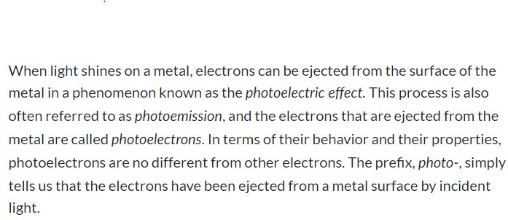
Photo-Electric Effect

Slide 3
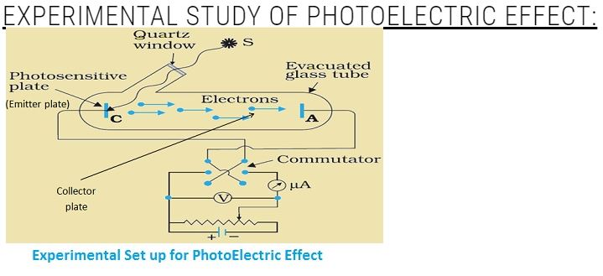

Slide 4
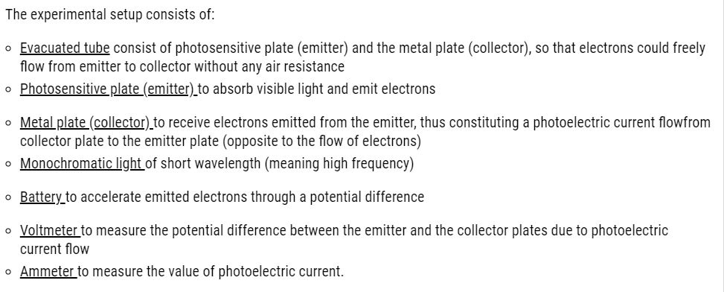

Slide 5
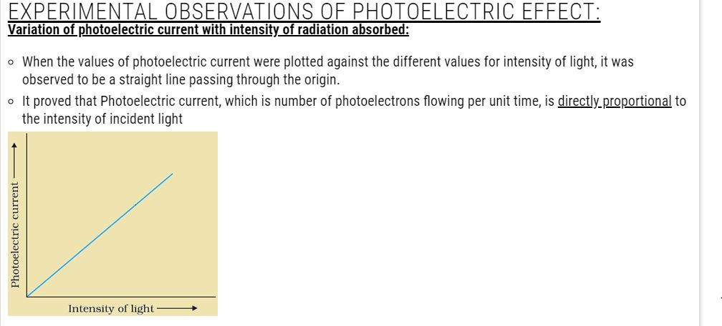

Slide 6
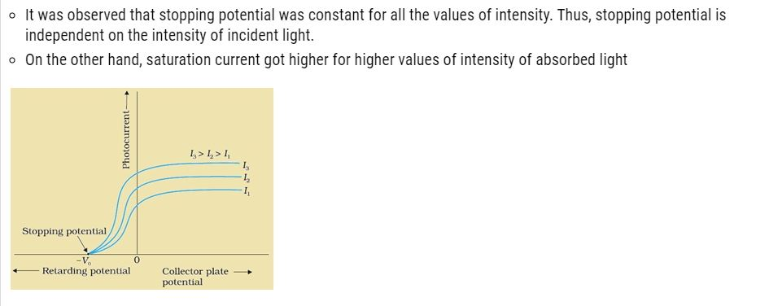
Variation of photoelectric current with the potential applied:
When the variation of photoelectric current was plotted against the potential for 3 different values of intensity of incident light (keeping frequency constant).

Slide 7
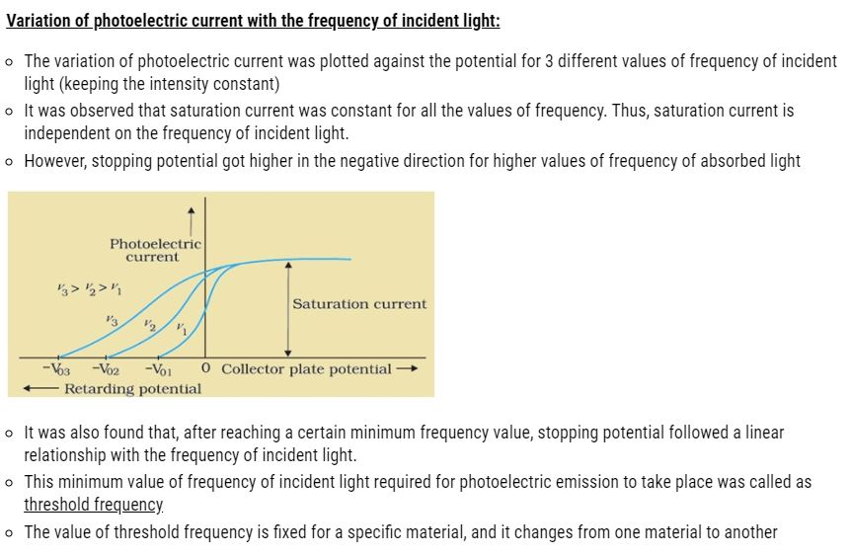
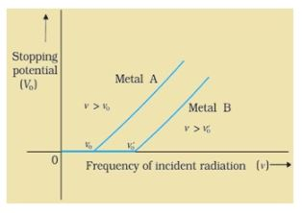

Slide 8
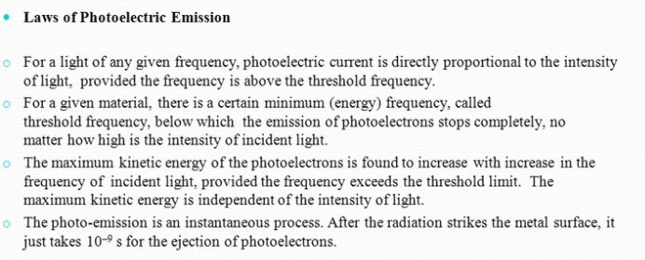

Slide 9
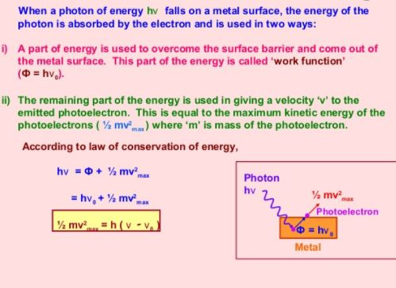
Einstein’s Photo-Electric Equation:

